Slide 1

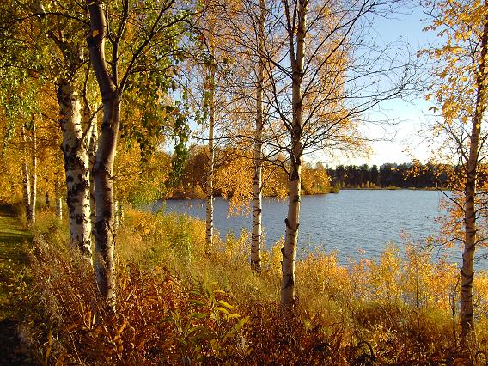
Sustainability of Natural Resources

Slide 2
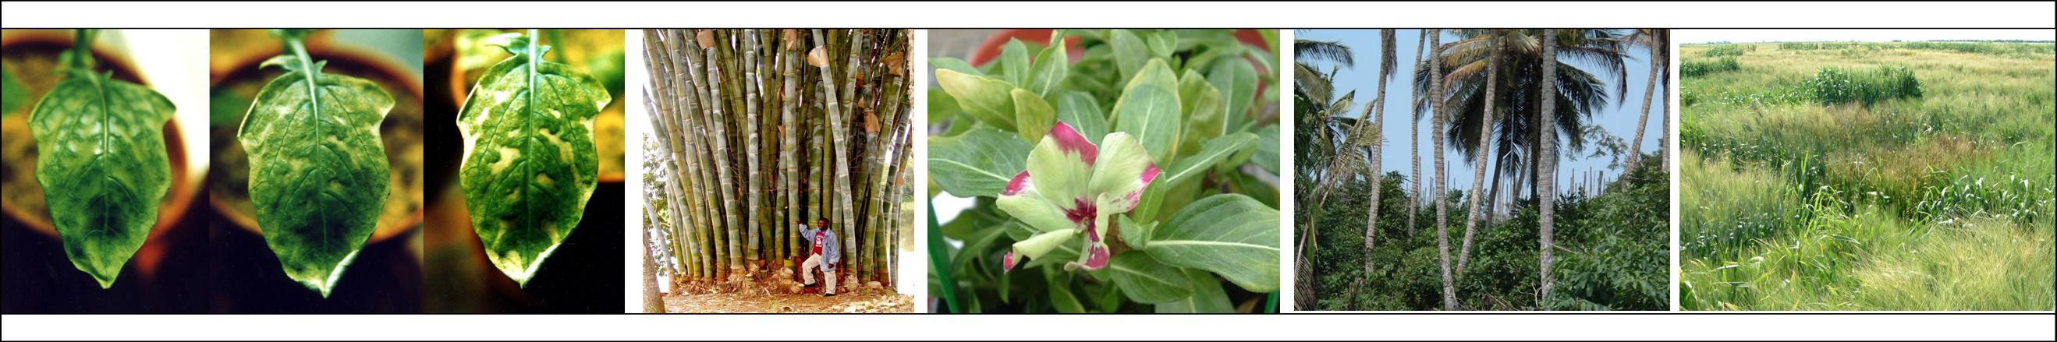
Ways to Distinguish Natural Resources: Biotic versus Abiotic
Biotic resources are “living” organisms
Fish, wildlife, range grasses, and trees
Abiotic resources are “nonliving”
Minerals, air, water, solar radiation, and atomic radiation
Oil and coal were once living matter
Soil has a mix of biotic and abiotic properties

Slide 3
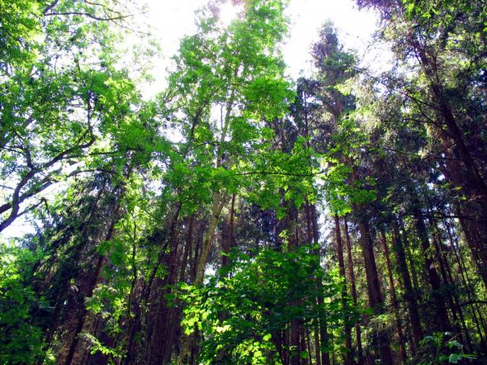
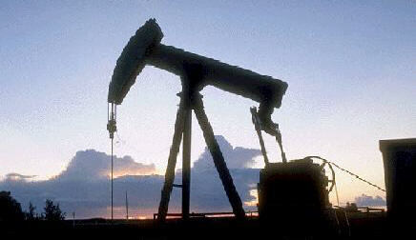
Ways to Distinguish Natural Resources: Renewable and Nonrenewable
Does human use of a resource allow it to be used more than once?
Renewable
Examples: soil, range, forest, wildlife, fisheries, water, air
Depletabale? Degradable?
Nonrenewable (in fixed quantity)
Examples: coal, oil, uranium, nonmetallic minerals, metallic minerals
Recyclable?

Slide 4

Ownership of Natural Resources: Public versus Private
Forms of ownership
No ownership
Private ownership
Common Property
Why is land more likely to be owned privately than air?

Slide 5
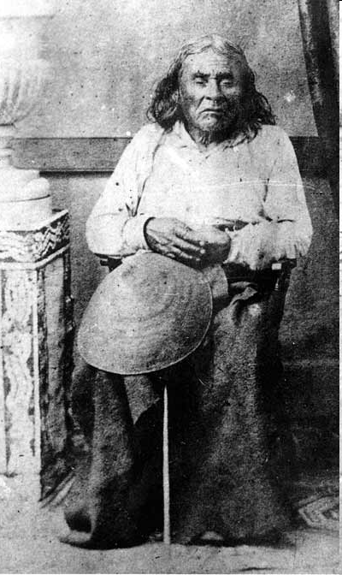
How Can You Buy and Sell The Earth?
“How can you buy or sell the sky, the warmth of the land? The idea is strange to us.
If we do not own the freshness of the air and the sparkle of the water, how can you buy them?
Every part of this earth is sacred to my people. Every shining pine needle, every sandy shore, every mist in the dark woods, every clearing and humming insect is holy in the memory and experience of my people.
The sap which courses through the trees carries the memories of the red man.”
-- Words frequently attributed to Chief Seattle

Slide 6
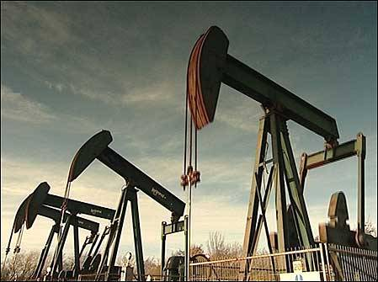

Exploitation versus Conservation Approaches
Exploitation
“Take all that you can in a cost-effective manner and move on.”
Conservation
“The efficient use of natural resources while protecting their capability for renewal (when they are renewable).”

Slide 7
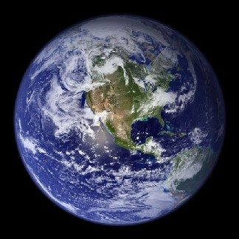
Will We Exhaust the Earth’s Resources?
Will growth overwhelm our ability to support, sustainably, the population?
Human misery
Famine
Disease
War
A long and unsettled debate
Malthus and the Dismal Science
Marxism versus Capitalism
Ehrlich v. Simon
Dire projections versus a belief that incentives will guide change (and technological advances)

Slide 8

Will We Exhaust the Earth’s Resources?
Role of price
Consider substitution of one resource for another
Role of technology
Gasoline fuel efficiency (average) increased from 13 mpg to 28 mpg in the 25 years following 1973.
In January 2008, new Corporate Average Fuel Economy (CAFE) standards were passed that will require that all new passenger vehicles in the United States average 35 mpg by 2020.

Slide 9
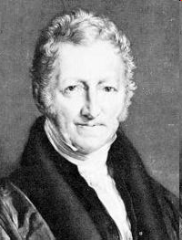
Will We Exhaust the Earth’s Resources? Thomas Robert Malthus (1766-1834)
English political economist and demographer.
Analyzed population growth and noted the potential for populations to increase rapidly, and often faster than the food supply available to them.
He noted that societies had historically experienced at one time or another epidemics, famines, or wars.
For Malthus, the fundamental problem was due to populations overstretching their resource limitations:

Slide 10
Will We Exhaust the Earth’s Resources?
Malthus predicted that the world population would exceed food supplies sometime between 1850-1900 (Kleiber 1961).
Malthusian catastrophe
Needless to say, Malthus was wrong.
In dismissing the prediction of Malthus, Henry George an economist noted:
"Both the jayhawk and the man eat chickens; but the more jayhawks, the fewer chickens, while the more men, the more chickens."

Slide 11


Will We Exhaust the Earth’s Resources? Ehlich versus Simon

Slide 12


Will We Exhaust the Earth’s Resources? Ehlich versus Simon
Paul R. Ehrlich wrote The Population Bomb (1968)
The book argued that mankind was facing a demographic catastrophe with the rate of population growth quickly outstripping growth in the supply of food and resources.
Julian L. Simon, a libertarian, was highly skeptical of such claims as outlined in his 1981 book (The Ultimate Resource).

Slide 13
Ehlich’s and Simon’s $1,000 Bet
Simon believed that commodities' inflation-adjusted price would be lower in the future. Simon offered a bet to Ehlich
Pick any raw material (chromium, copper, nickel, tin, and tungsten were chosen)
Select any date more than a year away (ten years was chosen – September 29, 1990)
$200 bet per materials (five were chosen)
Between 1980 and 1990, the world's population grew by more than 800 million, the largest increase in one decade in all of history.
Question: Who won the bet?

Slide 14
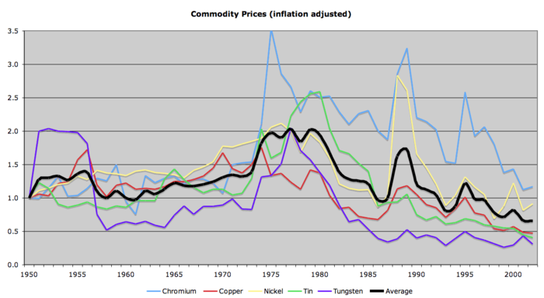
Simon Won.
However, by September 1990, without a single exception, the price of each of Ehrlich's selected metals had fallen, and in some cases had dropped significantly.
Chrome went from $3.90 a pound in 1980 to $3.70 in 1990.
Tin went from $8.72 a pound in 1980 to just $3.88.
In October 1990, Paul Ehrlich mailed Julian Simon a check for $576.07.

Slide 15
Simon's Cornucopian Theory
“More people, and increased income, cause resources to become more scarce in the short run. Heightened scarcity causes prices to rise.
The higher prices present opportunity, and prompt inventors and entrepreneurs to search for solutions. Many fail in the search, at cost to themselves. But in a free society, solutions are eventually found.
And in the long run the new developments leave us better off than if the problems had not arisen. That is, prices eventually become lower than before the increased scarcity occurred.”

Slide 16
Ehlich v. Simon: 2nd Bet (1994 – 2004)
1. The three years 2002–2004 will on average be warmer than 1992-1994.
2. There will be more carbon dioxide in the atmosphere in 2004.
3. There will be more nitrous oxide in the atmosphere in 2004.
4. The concentration of ozone in the lower atmosphere (the troposphere) will be greater than in 1994.
5. Emissions of the air pollutant sulfur dioxide in Asia will be significantly greater in 2004.
6. There will be less fertile cropland per person in 2004.

Slide 17
Ehlich versus Simon: 2nd Bet
7. There will be less agricultural soil per person in 2004.
8. There will be on average less rice and wheat grown per person in 2002–2004 than in 1992-1994.
9. In developing nations there will be less firewood available per person in 2004.
10. The remaining area of virgin tropical moist forests will be significantly smaller in 2004.

Slide 18
Ehlich versus Simon: 2nd Bet
11. The oceanic fisheries harvest per person will continue its downward trend and thus in 2004 will be smaller than in 1994.
12 There will be fewer plant and animal species still extant in 2004.
13. More people will die of AIDS in 2004.
14. Between 1994 and 2004, sperm cell counts of human males will continue to decline and reproductive disorders will continue to increase.
The gap in wealth between the richest 10% of humanity and the poorest 10% will be greater in 2004.

Slide 19
Ehlich versus Simon: 2nd Bet
Simon declined Ehrlich and Schneider's offer to bet, and used the following analogy to explain why he did so:
“Let me characterize their offer as follows. I predict, and this is for real, that the average performances in the next Olympics will be better than those in the last Olympics.
On average, the performances have gotten better, Olympics to Olympics, for a variety of reasons.
What Ehrlich and others says is that they don't want to bet on athletic performances, they want to bet on the conditions of the track, or the weather, or the officials, or any other such indirect measure.”

